Slide 1
Networking and the internet
Lesson 4: The internet

Slide 2
Objectives
In this lesson, you will learn:
that the internet is a global collection of computer networks
about the different types of internet services
what is meant by cloud computing
the pros and cons of cloud computing.

Slide 3
The internet
Most people use the internet all the time. You probably use it every day.
But do you know what the internet is?
Do you know how it works?

Slide 4
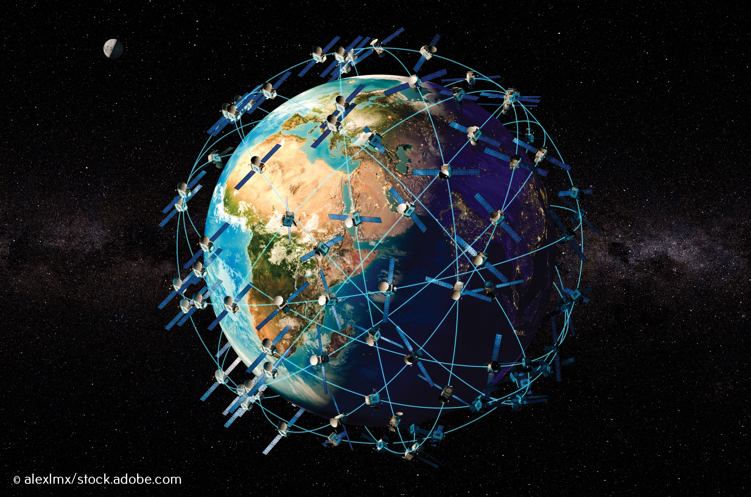
A global collection of computer networks
Most schools, offices and homes have a network.
These networks join together to form the internet, which connects over 50 billion devices worldwide.

Slide 5
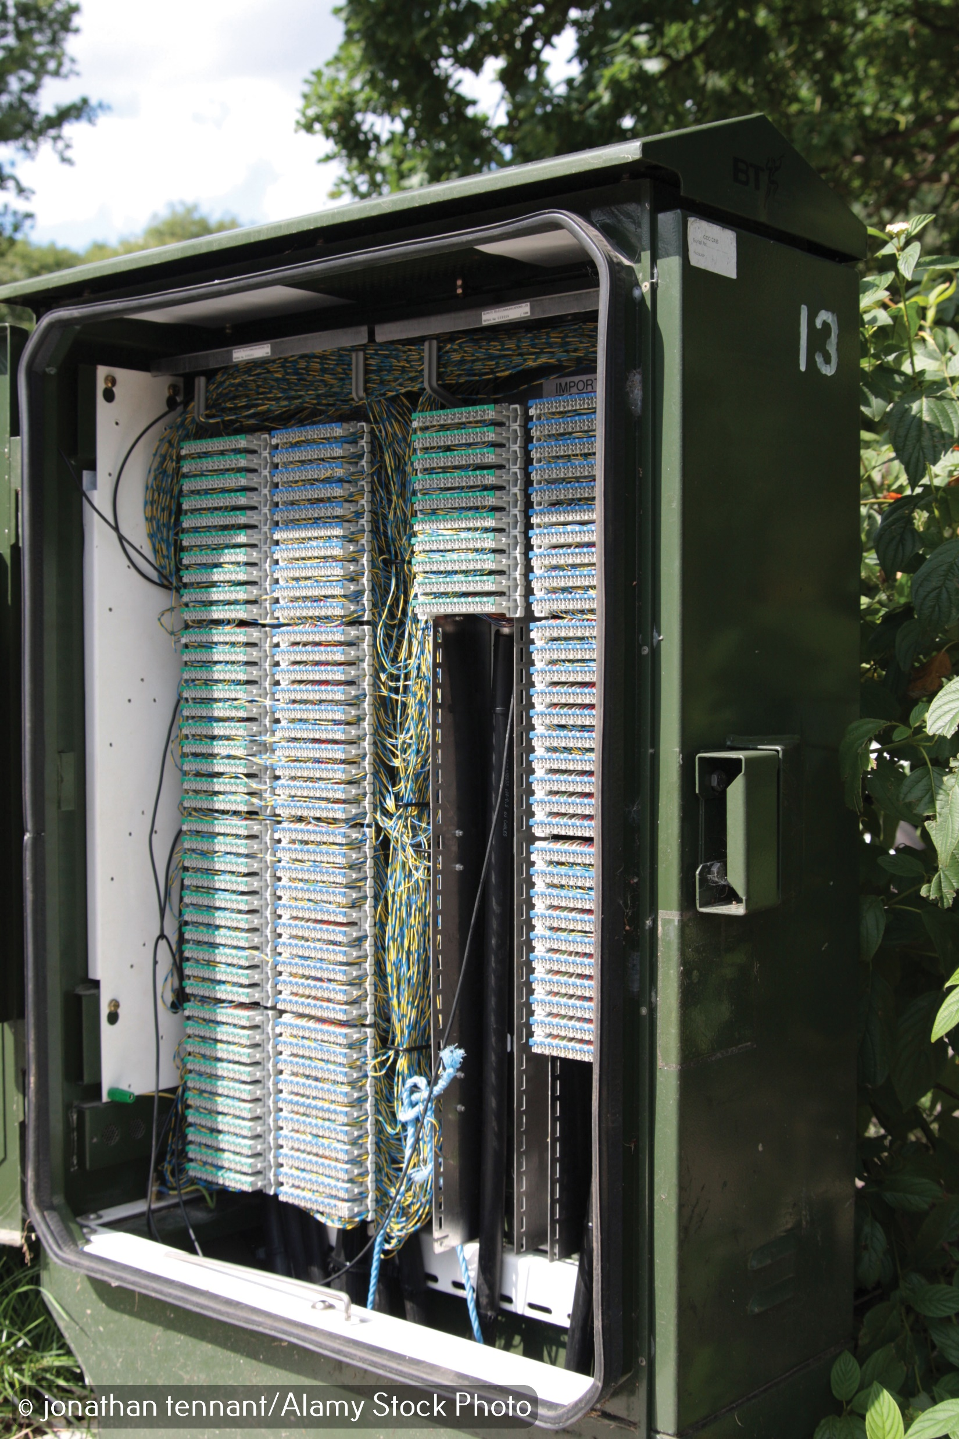
Cables
The simplest method of joining networks together is using cables.
It isn't practical to run cables between all the schools, offices and homes in a country, so existing telephone cables are used.
Telephone cabinets contain the cables that connect networks to the internet.

Slide 6

Submarine cables
Special submarine (under-sea) cables are used to connect networks across seas and oceans.
These cables carry very high volumes of data at very high speed. They are very expensive and very important.
If the cables are damaged, then whole countries can lose their internet connection.
Watch this video

Slide 7

Activity 4.1 Submarine cables

Slide 8
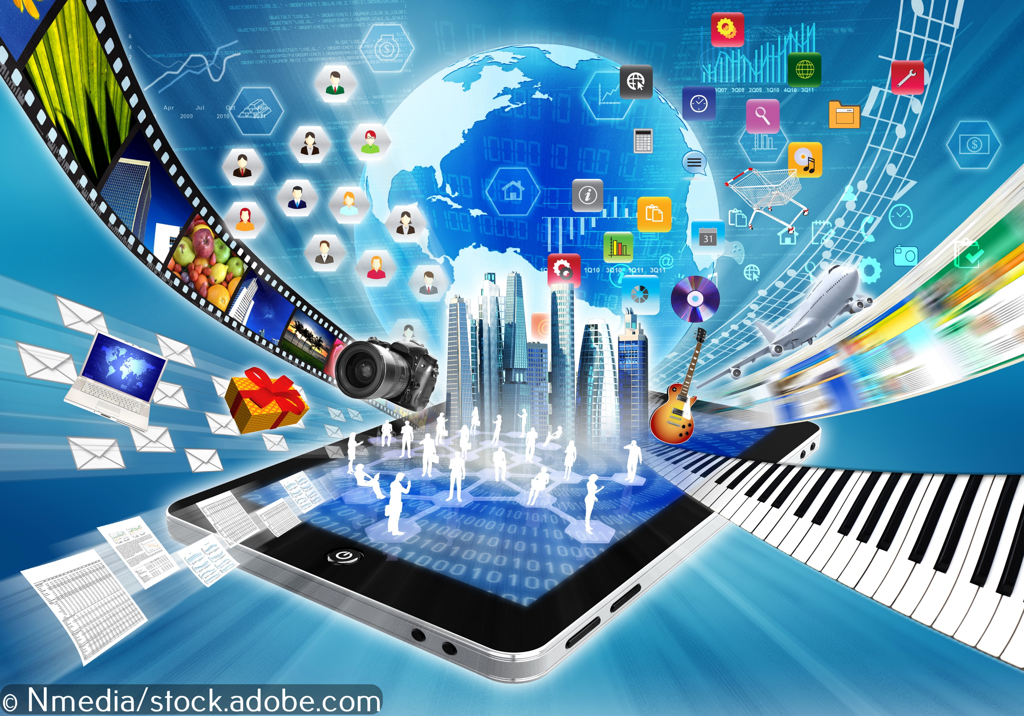
Online services
Connecting computers over the internet means that many services are available online.
An online service set up and run in one country can be accessed by anyone, anywhere in the world.

Slide 9
Activity 4.2: Online services

Slide 10

Cloud computing
Cloud computing means running programs and storing files on the internet.
Cloud computing involves taking things that would be traditionally done on a computer and hosting them online so that they can be accessed from anywhere.

Slide 11
The advantages of cloud storage
Many business backup their files online and many people back up their photos online.
Storing your files and photos online in the cloud has many advantages, including:
you can access your data on more than one device
you can access your data anywhere in the world if you have an internet connection
you will not lose your data if your device is lost, stolen or damaged
there is, potentially, unlimited storage
you can easily share your data with other people.

Slide 12

The disadvantages of cloud storage
However, there are disadvantages to storing files and photos online.
You can store only a relatively small amount of data for free.
Monthly fees for extra storage can be expensive.
Cyber criminals can potentially access your files from a cloud server without accessing your computer or phone. They can then ransom them, delete them or steal sensitive information.

Slide 13
The advantages of cloud software
Many people and business now use online software, including word-processing, spreadsheet and photo- and video-editing software.
Using online software has many advantages, including:
you do not need to install software on your computer
you never have to worry about software updates
you’re less likely to be affected by malware because the data and programs are not stored on your computer
you can work on your files anywhere using any device if you have an internet connection
you don’t need a powerful computer because the processing is done by the server running in the cloud
some of the most popular online software, including Google Docs, Google Sheets and Office Online, is free.

Slide 14
The disadvantages of cloud software
However, there are also disadvantages of running software in the cloud.
You can only access online software if you’re online.
Online image-editing and video-editing software is getting better, but it can be very slow.
Online versions of software often have fewer features than the downloadable versions.
The software developer may earn money selling advertising, so you may be distracted by a lot of adverts.
The software company may have access to your work and could sell this information to someone else.

Slide 15
Activity 4.3: Cloud computing

Slide 16
Activity 4.4: Toppers (Part 4)

Slide 17
Quiz 4

